Slide 1
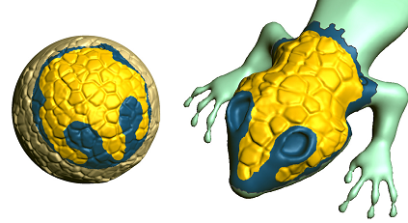
GeoBrush: Interactive Mesh Geometry Cloning
Kenshi Takayama^{1, 2}
Ryan Schmidt³
Karan Singh³
Takeo Igarashi¹
Tamy Boubekeur⁴
Olga Sorkine^{2, 5}
¹University of Tokyo
²New York University
³University of Toronto
⁴Telecom ParisTech – CNRS
⁵ETH Zurich

Slide 2
Cloning brush for image editing
[McCann08]
Incremental update of cloned area
Can it be extended to geometry editing?
Notes:
For images, cloning brush is a pretty common way of content reuse, and is available in many packages such as Adobe Photoshop.
And the tool is used for various purposes such as composition, hole filling, and image repair.
Our goal in this work is to provide a similar tool for 3D surface meshes.

Slide 3
Our goal: Cloning brush for geometry editing
Incremental update of ROI

Slide 4
Previous approaches

Slide 5
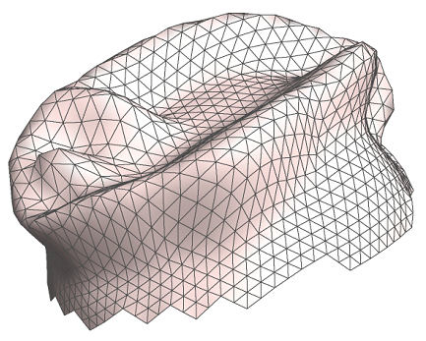
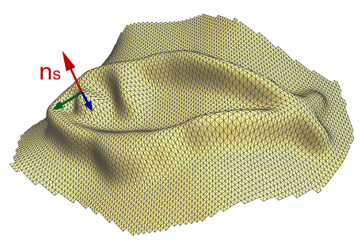
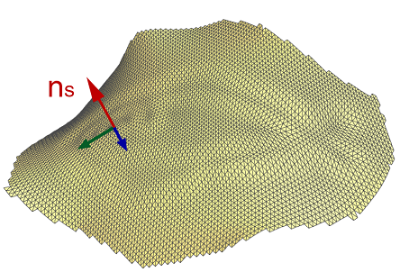
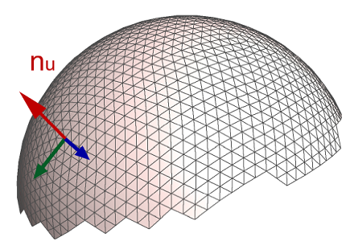
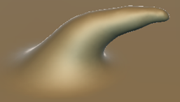
Copying displacements
[Biermann02]
MudBox
ZBrush
Source
Smoothed source
Target
Cloned result
Cannot handle non-displacement features
Topological handles
Extreme extrusions
Notes:
One previous approach to cloning surface features is based on copying displacements.
An early work was done by Biermann et al. in 2002, and the similar idea is implemented in several commercial packages such as MudBox and Zbrush.
The basic idea is to apply excessive smoothing to the source to extract surface displacements, and then copying them to the target.
However, this approach has several drawbacks.
First, it cannot handle different topologies such as handles and holes.
Second, applying excessive smoothing may result in degeneracy for some shapes, which is undesirable.
And third, it is problematic for very curved target, causing spiky artifacts or even self intersections.

Slide 6
Variational optimization
[Sorkine04]
[Yu04]
[Sharf06]
[Fu07]
Poisson eqn.
Bi-Laplacian eqn.
Computationally expensive
One-time cloning operation only
Notes:
The other more recent approach is based on variational optimization.
Early work was done by Sorkine et al. and Yu et al. in 2004, and since then this approach has received much attention in the field.
It can transplant entire parts such as wings, arms, and legs, and its core idea is to solve a variational optimization problem such as Poisson equation and bi-Laplacian equation.
Although it can produce high quality results, the obvious drawback is that it’s computationally expensive, which only allows one-time cloning operations, and cannot achieve continuous cloning brush.

Slide 7
Our new tool: GeoBrush
Notes:
Now we introduce our new tool called “GeoBrush”.

Slide 8
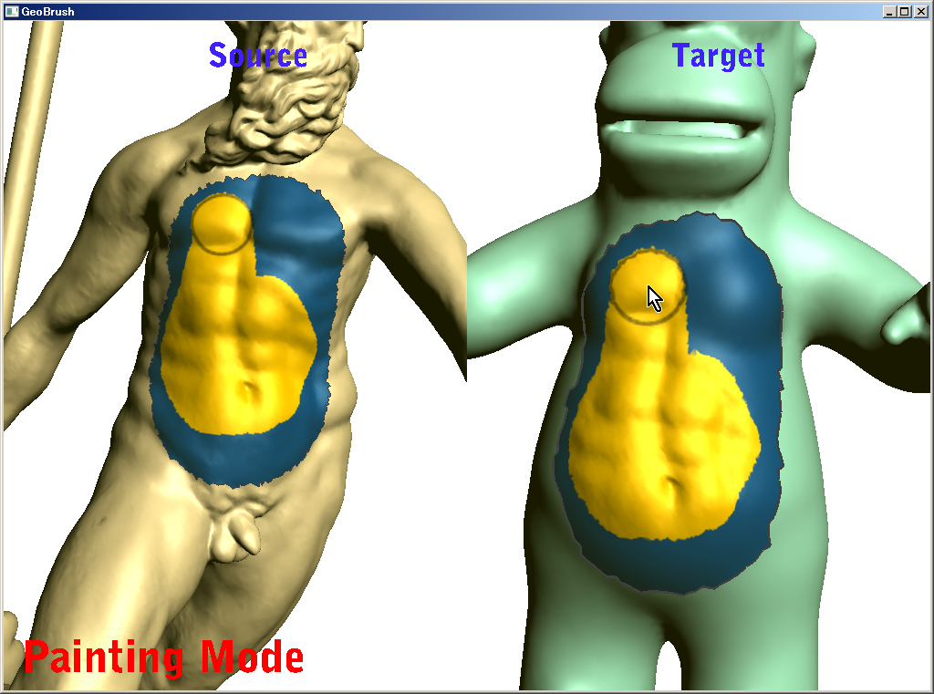
Features
Real-time paintbrush metaphor
Non-displacement features
Topology-aware ROI correction
Quality results
Smooth stitching
No resampling
Demo!
Notes:
Here are features of our GeoBrush.
It can handle non-displacement features such as handles and extreme extrusions.
It ensures C1 continuity across region of interest boundaries.
No resampling is needed while cloning, which means all the geometric details are nicely preserved.
And of course it works in real-time.
Here I’m going to show a quick demo.
===============(live demo)====================
The source and target models are shown at the left and right, respectively.
First I need to parameterize the source model locally by scribbling.
Next, I click on the target model to specify the corresponding parameterization. I can interactively change the position, orientation, and scaling.
Having completed these parameterization as a preprocess, now we can clone the source onto the target with a brush in real time.
We can copy non-displacement features like handles and extreme extrusions.
Note the smoothness across the boundary of the cloned part.
The original mesh connectivity is preserved and no resampling is needed.
Also it is possible to change the target parameterization while retaining the cloned area.

Slide 9
Algorithm (in 2D)

Slide 10
Canvas setup
Screen
Scribble
$$u=1$$
$$u=0$$
$$u=1$$
Target canvas
Source canvas
$$u=0$$
Parameterize
Parameterize
Source mesh
Target mesh
$$u=0$$
$$u=1$$
Discrete exponential map [Schmidt06]
1D parameter space
Notes:
Note that this parameterization for the source canvas is not a classical one-to-one mapping. Rather, it’s like a projection, and allows foldovers and holes.

Slide 11
Canvas setup
Source cage
Target cage
Green Coordinates [Lipman08]
Bit slow (5 sec)
Very fast (0.1 sec)

Slide 12
ROI painting
Screen
paint
Gaps
Offset function $f$

Slide 13
How to compute offset function $f$
$$f∶\left[0, 1\right]⟼ℝ^{2}$$
$$u=0$$
$$u=1$$
such that:
1D parameter space
$$∆^{2}f = 0$$
Smoothness
$${\left.f\right|}_{∂Ω} ={ P}_{tgt}−P_{src}$$
Positional constraints
$${\left.\frac{df}{du}\right|}_{∂Ω}=\frac{dP_{tgt}}{du}−\frac{dP_{src}}{du}$$
Tangential constraints
Bi-harmonic solver on GPU
GPU setup inspired by Poisson solver [McCann08]

Slide 14
ROI painting
Screen
paint

Slide 15
ROI painting
Screen
paint
paint

Slide 16
Stitching mesh
Screen
paint
Offset
Stitching mesh

Slide 17
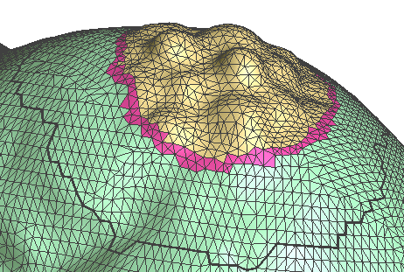
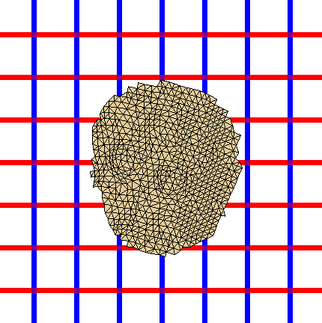
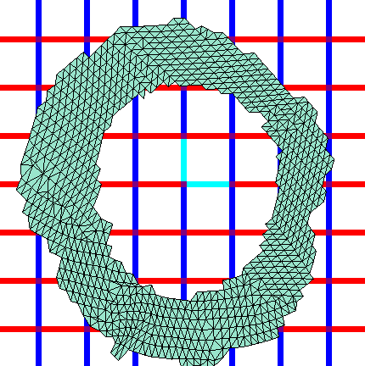
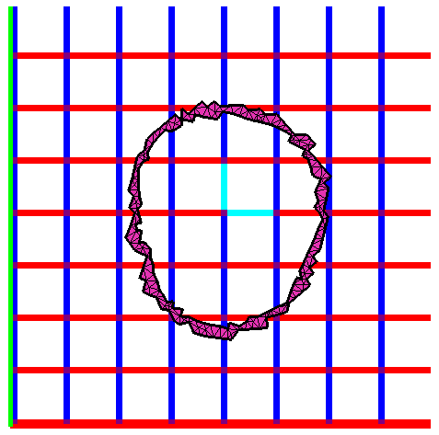
Stitching mesh (in 3D)
3D space
2D parameter space
2D Delaunay triangulation = fast!
Benefit of parameterization

Slide 18
Topology-aware ROI correction

Slide 19
Without ROI correction
ROI boundaries of source/target are topologically inconsistent
Notes:
Because we use a projection-like parameterization, the user might paint an invalid ROI configuration, as shown below.
Here, the cloned boundary of the source and target are topologically inconsistent.
Our goal is to detect and correct such invalid configurations.
The algorithm is as follows.

Slide 20
With ROI correction
Detect/correct bad ROIs
At every paint by the user

Slide 21
Step 1 (at canvas setup stage)
Identify reversed faces
Parameterized source canvas
Reversed faces
Source canvas
Notes:
After the parameterization of the source canvas, we collect reversed faces as shown in orange here. This is pretty easy to compute.

Slide 22
Step 2 (at ROI painting stage)
Detect partially-painted reversed faces
ROI
Detected!
ROI boundary
Notes:
Then, while the user is painting the ROI in real time, the system first traces the ROI boundary, and if it crosses any reversed faces, the system detects it as an invalid configuration.

Slide 23
Step 3 (at ROI painting stage)
Add projection of reversed faces to ROI
ROI
Added ROI
Corresponding reversed faces
ROI boundary
Notes:
And the corresponding set of reversed faces are added back to the ROI, resulting in a valid ROI configuration.

Slide 24
Results

Slide 25
Completing missing details (1/3)
Notes:
This is an example of copying details from other models.
The original surface mesh was obtained from stereo acquisition, which was then completed with GeoBrush.

Slide 26
Completing missing details (2/3)
Notes:
This is an example of copying details from other models.
The original surface mesh was obtained from stereo acquisition, which was then completed with GeoBrush.

Slide 27
Completing missing details (3/3)
Notes:
This is an example of copying details from other models.
The original surface mesh was obtained from stereo acquisition, which was then completed with GeoBrush.

Slide 28
Complex ROI shapes

Slide 29
ROI correction in use
Notes:
This example illustrates the automatic ROI correction feature in use.
The user can easily select and deselect individual scale-like features by just clicking.

Slide 30
Performance (typical case)
Green Coordinates (step 1)
5s
Green Coordinates (step 2)
70ms
Parameterization
Cage deformation
50ms
Target canvas setup: 120ms
Bi-harmonic solver
100ms
Boundary tracing
ROI correction
Stitching
Parameterization
Cage construction
70ms
500ms
Source canvas setup: 5.5s
ROI painting: 170ms

Slide 31
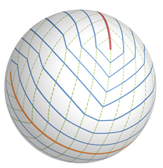
Limitations & future work
Other types of canvas topologies
Cylindrical
Spherical
Notes:
Here are some limitations and future work.
We currently assume that the canvas domain is topologically a disk, but supporting other types of canvas topologies, such as cylindrical and spherical ones, would be useful in practice.

Slide 32
Limitations & future work
Interactively changing source canvas
Like Photoshop “Patch Tool”
Bottleneck: computation of Green Coordinates
Photoshop “Patch Tool”
Notes:
Another limitation is that our system currently does not support interactively changing the source canvas.
Such a functionality would be very useful in practice, much like Adobe Photoshop’s “Patch Tool” depicted below.
The bottleneck that prevents us from achieving that is the GC preprocessing which consists of cage construction and coordinate computation steps.
In future we would like to explore other faster alternatives for computing intermediate deformations of the source canvas.

Slide 33
Summary (users’ perspective)
Paintbrush interface for geometry cloning
Can deal with non-displacement features
Can move target canvas after painting ROI

Slide 34
Summary (technical aspects)
Parameterization by Discrete Exponential Map
Rough deformation by Green Coordinates
Offset membrane by GPU bi-harmonic solver

Slide 35
Acknowledgements
Scott Schaefer, Eric Landreneau
3D models with scale-like features
Alexander Hornung, EG reviewers
Valuable comments
Supported by
JSPS
NSF award IIS-0905502
MITACS
3DLife EU N.o.E.
Adobe Systems, Inc.
Notes:
We want to thank Scott Schaefer and Eric Landreneau for providing us with their beautiful 3D models of scale-like features.
We also thank Alexander Hornung and anonymous reviewers for their valuable comments.
This work was funded in part by the following agencies.

Slide 36
Thanks!
Demo app (+ source code) available at:
www-ui.is.s.u-tokyo.ac.jp/~kenshi/GeoBrush
Notes:
The demo app and the source code are publicly available at this URL.
Please go download them and try for yourself!
Thanks!

Slide 38
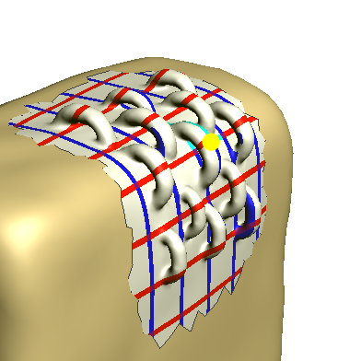
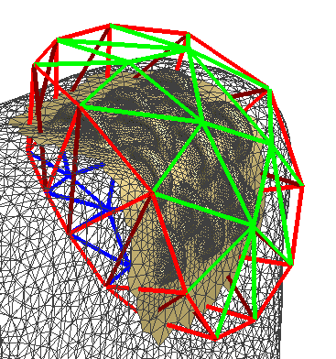
Cage construction
Goal: create a crude cage that encloses canvas
Notes:
The goal here is to create a crude cage that encloses the canvas.

Slide 39
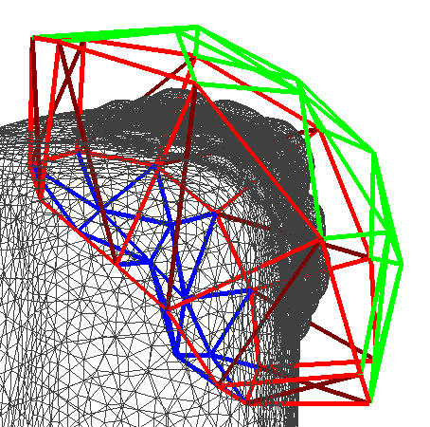
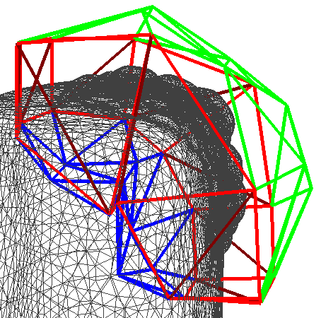
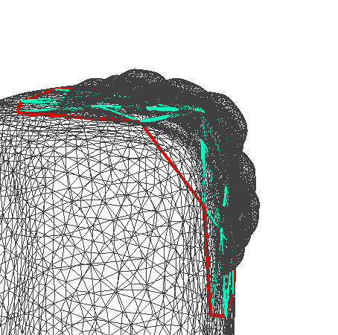
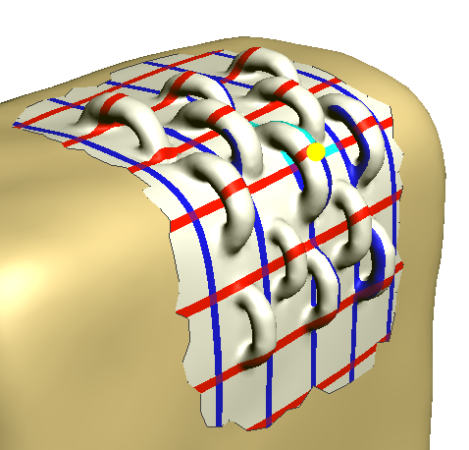
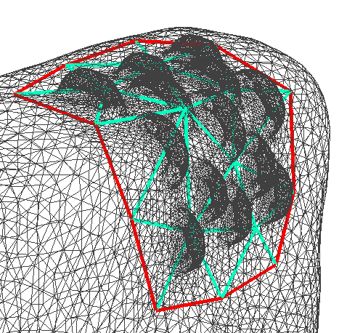
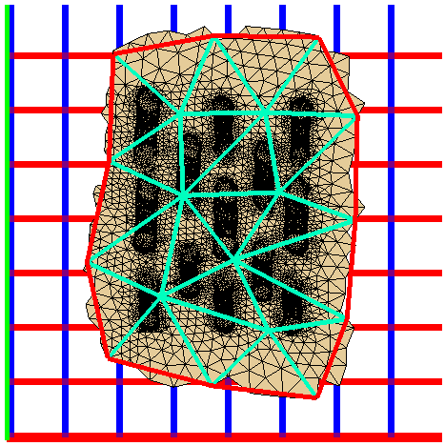
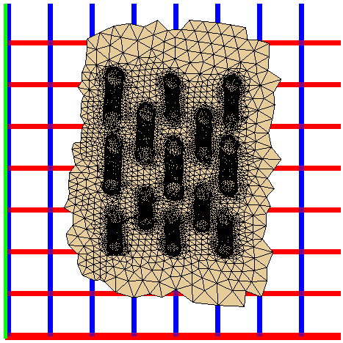
Cage construction
Back projection
2D triangulation
Laplacian mesh optimization [Nealen06]
Offset along normals
Notes:
Given the canvas patch and its parameterization into 2D, we first coarsely triangulate the 2D domain, then map it back to 3D, then offset it along normal directions to obtain a shell-like mesh connectivity. This may result in badly shaped triangles and self-intersections, so we finally apply Laplacian mesh optimization algorithm proposed by Nealen et al. in 2006.

