Slide 1
Sketch-Based Generation and Editing of Quad Meshes
Kenshi Takayama
ETH Zurich
Daniele Panozzo
ETH Zurich
Alexander Sorkine-Hornung
Disney Research Zurich
Olga Sorkine-Hornung
ETH Zurich

Slide 2
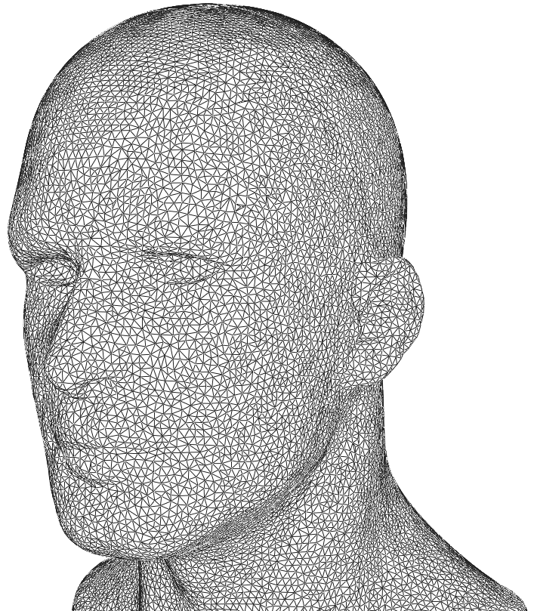
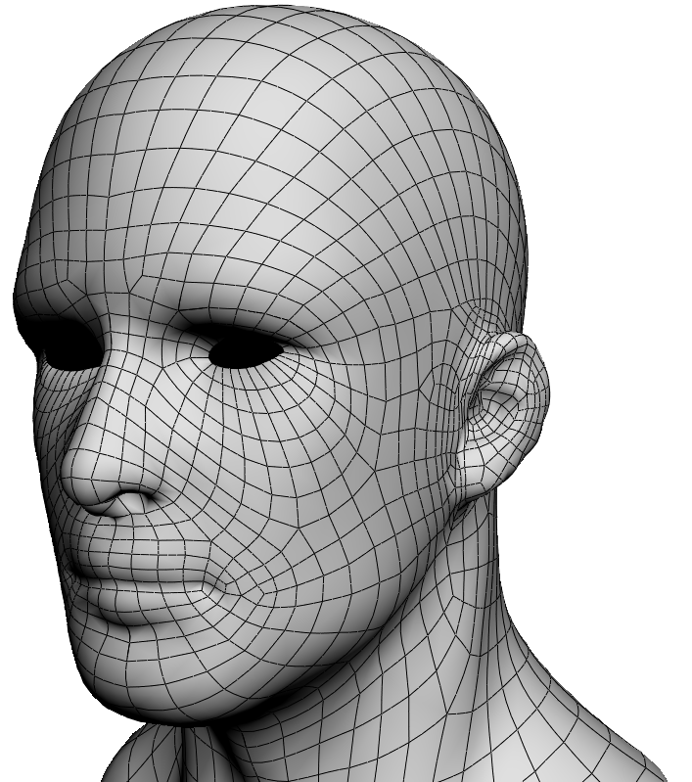
Quad remeshing (aka. retopology)
Input
Triangle mesh
Quality determined by:
Edge flow (loop)
Singularity
Output
High-quality quad mesh
Notes:
our work is about quad remeshing, aka, retopology
where the input is a triangular mesh with arbitrary mesh connectivity,
ant the output is a high-quality quad mesh with a desirable mesh connectivity.
the quality of quad mesh is largely determined by the so-called “edge flows” or “edge loops”,
which are loosely defined as sequences of edges that can be seen locally as grid lines.
another important aspect of a quad mesh is the layout of singularities,
which are vertices shared by more or less than 4 quads

Slide 3
CG animation production pipeline
Sculpting
Retopology
Rigging
Rendering
Notes:
retopology is especially important for producing CG animations
which starts by creating 3D shapes using virtual sculpting tools
but the mesh created at this stage might not be optimal for the later stages of the pipeline,
so in the next step of retopology, the artist redefines a better mesh connectivity,
such that the remaining stages of the pipeline, including rigging, animation, and rendering, become more efficient.

Slide 4
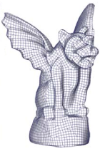
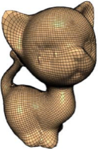
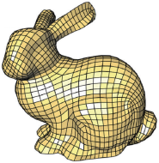
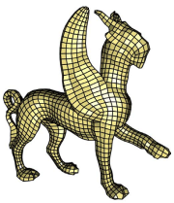
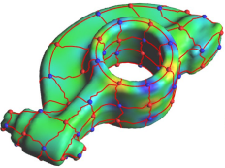
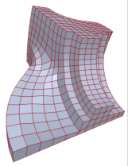
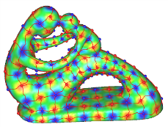
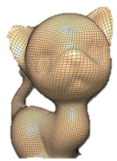
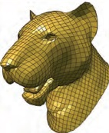
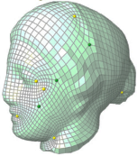
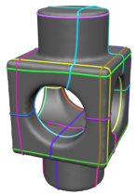
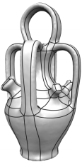
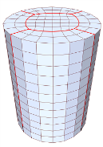
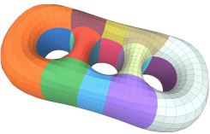
Automatic generation
Coarse meshing still difficult
No direct control over topology
[Ray06]
[Dong06]
[Tong06]
[Kälberer07]
[Huang08]
[Bommes09]
[Zhang10]
[Kovacs10]
[Daniels11]
[Tierny11]
[Bommes11]
[Tarini11]
[Campen12]
[Bommes13]
Notes:
automatic generation of quad meshes has been researched extensively over the past decade,
with many successful approaches proposed recently.
however, it is still difficult to generate extremely coarse meshes using these automatic methods.
another serious issue is that none of them allow direct control over the final mesh topology,
which is what artists really care about.

Slide 5
Manual creation
Too basic
Difficult to fill gaps
Little research effort so far!
Notes:
because of these reasons, it is still common today among artists to manually create quad meshes using tools such as 3D-Coat as shown here.
however, as you can see, these tools are too basic at the moment, requiring lots of redundant user input.
also, it is not easy at all to fill gaps between partially created meshes.
surprisingly, in the research community, there has been very little effort devoted to this direction.
so our motivation is to propose some improvements here.

Slide 6
Basic idea
Directly sketch edge flows
4-sided region ➔ patch
T-junction
3-sided patch
Notes:
the basic idea of our approach is to allow the user to directly sketch edge flows as freeform curves.
when such curves form a 4-sided region, the region becomes a patch consisting of multiple quads.
so the user’s task is to design a curve network that partitions the surface into patches.
our curve network representation is flexible, allowing T-junctions and 3-sided patches as well.

Slide 7
Basic idea
number of subdivisions at patch boundary
Patch interior automatically quadrangulated
Singularities inside patch
Notes:
after specifying the patch layout, the user can control the topology of the resulting quad mesh by specifying the number of edge subdivisions at the patch boundaries.
(STOP WRITING SCRIPT FOR NOW! I can do it after the talk.)

Slide 8
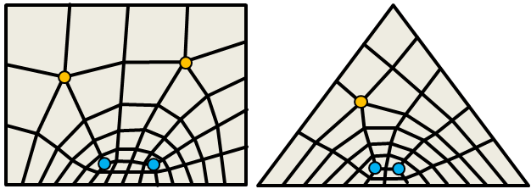
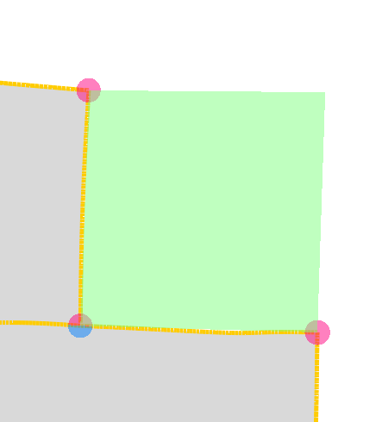
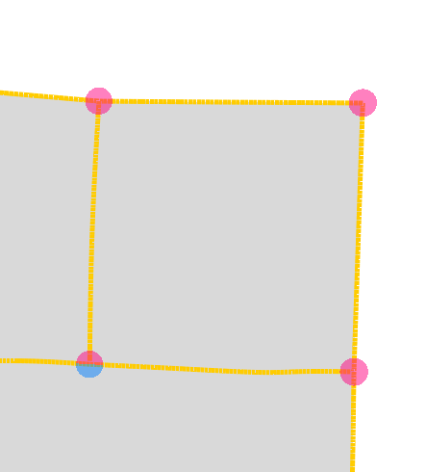
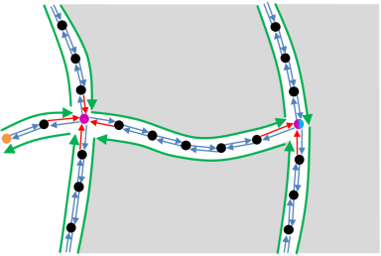
Outline
User interface
Algorithm & implementation

Slide 9
Outline
User interface
Algorithm & implementation

Slide 10
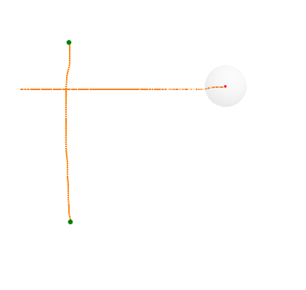
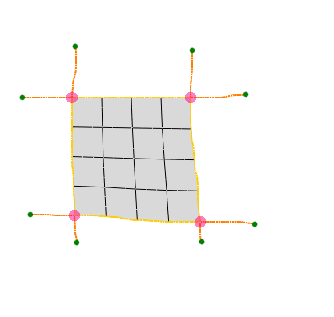
Basic sketching

Slide 11
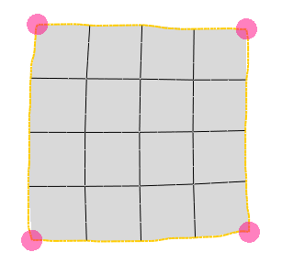
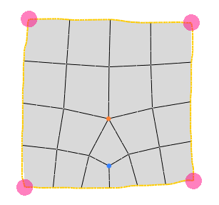
Topology editing

Slide 12
Spine sketching

Slide 13
Autocompletion

Slide 14
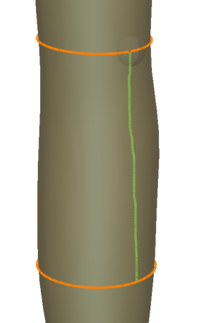
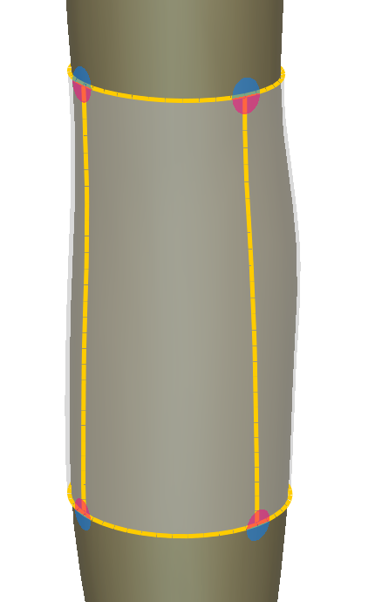
Cylinder sketching

Slide 15
Outline
User interface
Algorithm & implementation

Slide 16
Patch quadrangulation algorithm
4
Input
# of edge subdivisions at patch boundary
Output
Quadrangulation of patch interior
?
5
6
corner
7

Slide 17
Patch quadrangulation algorithm
Tech Report [Takayama13]
Generalization of [Nasri09]
Pure quads
Guaranteed to always work
1
1
4
8

Slide 18
Curve network representation
Sketched curve level
Quad mesh level
Curve points
Halfedges
“Halfchains”
Patches
ref
ref
ref

Slide 19
Spine sketching & autocompletion
UV space
Stroke parameterization [Schmidt13]
Analyze nearby patches in UV space
Autocompletion:
Check nearby corners

Slide 20
Results

Slide 21
User evaluation with artists

Slide 22
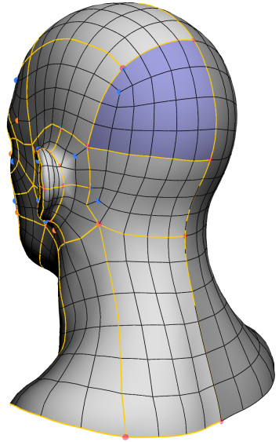
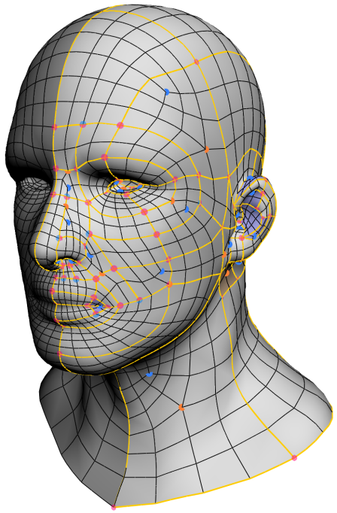
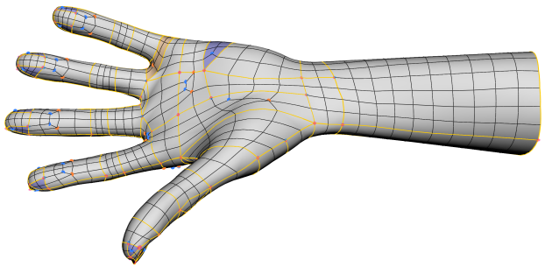
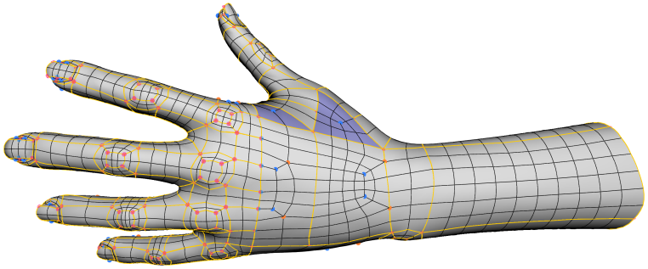
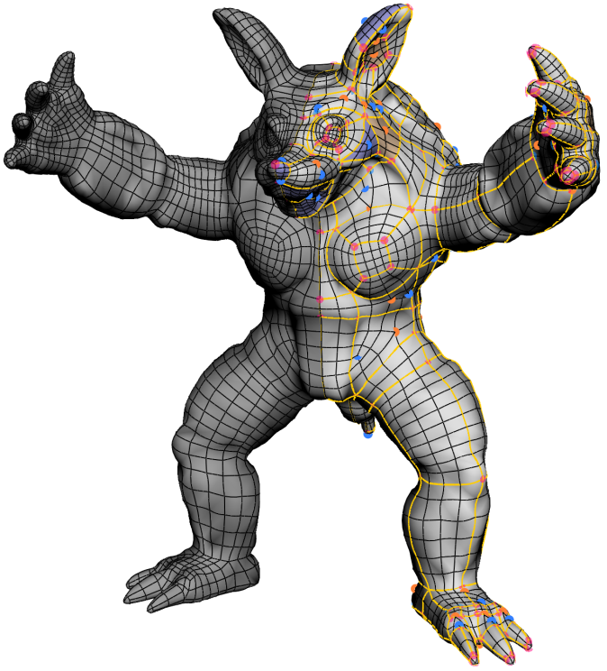
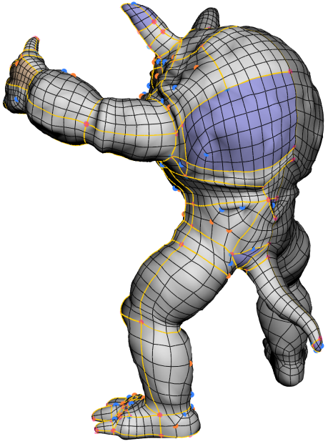
Results by artist #1
50min
120min
Modeling time: 70min

Slide 23
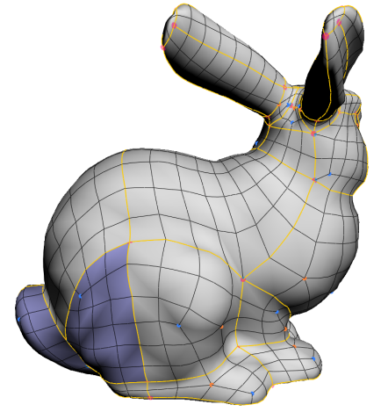
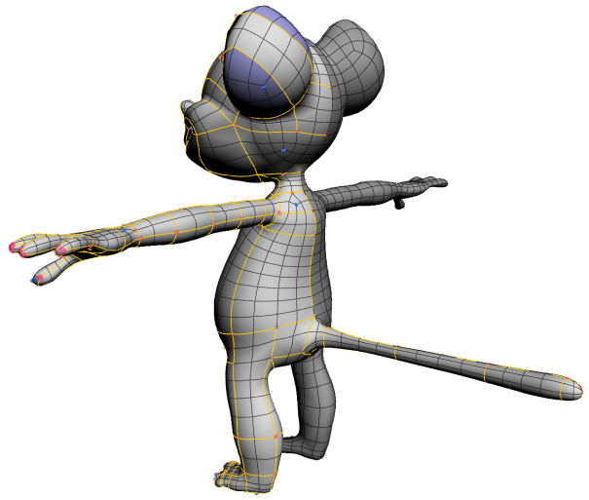
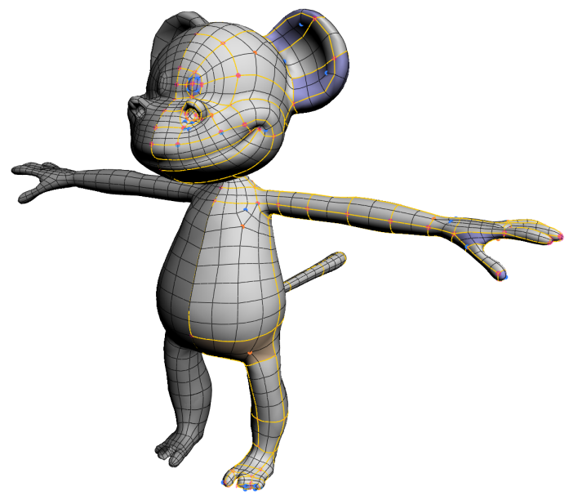
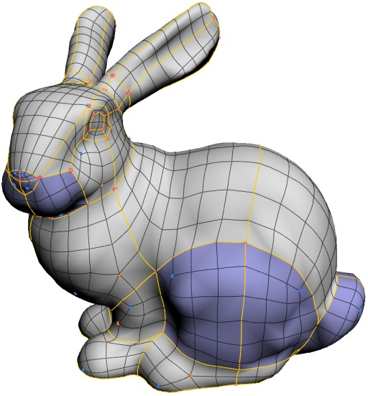
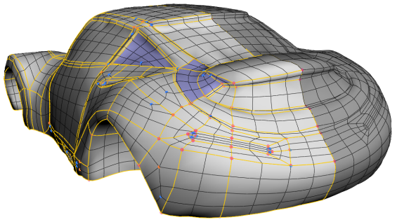
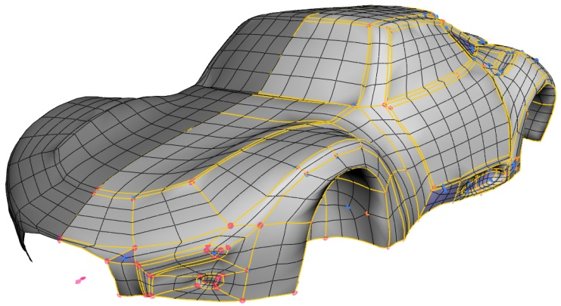
Results by artist #2
80min
90min
50min

Slide 24
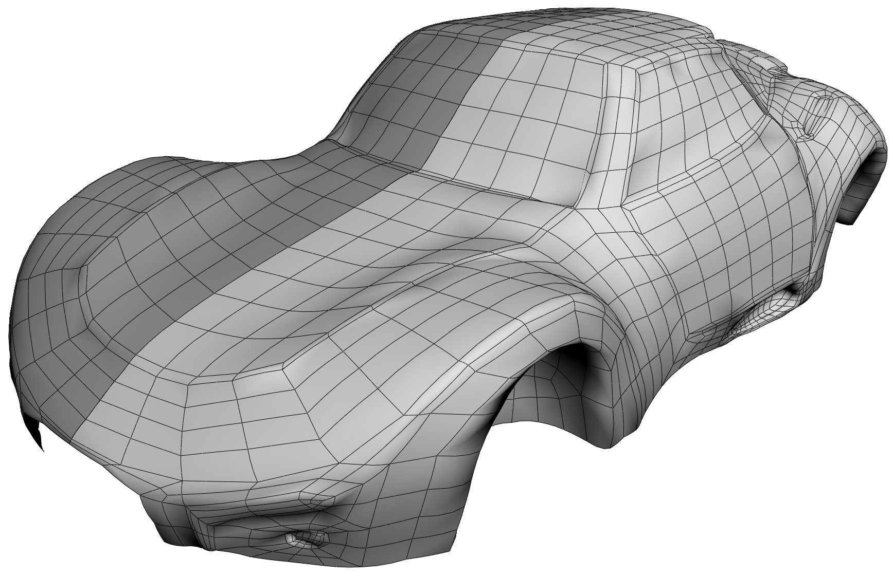
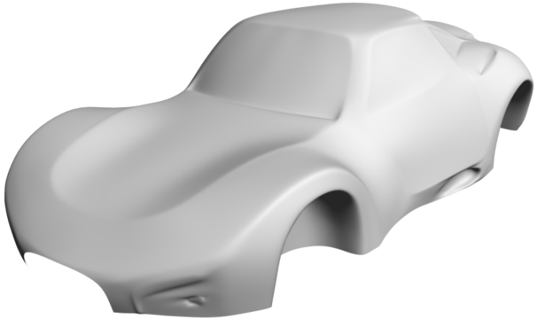
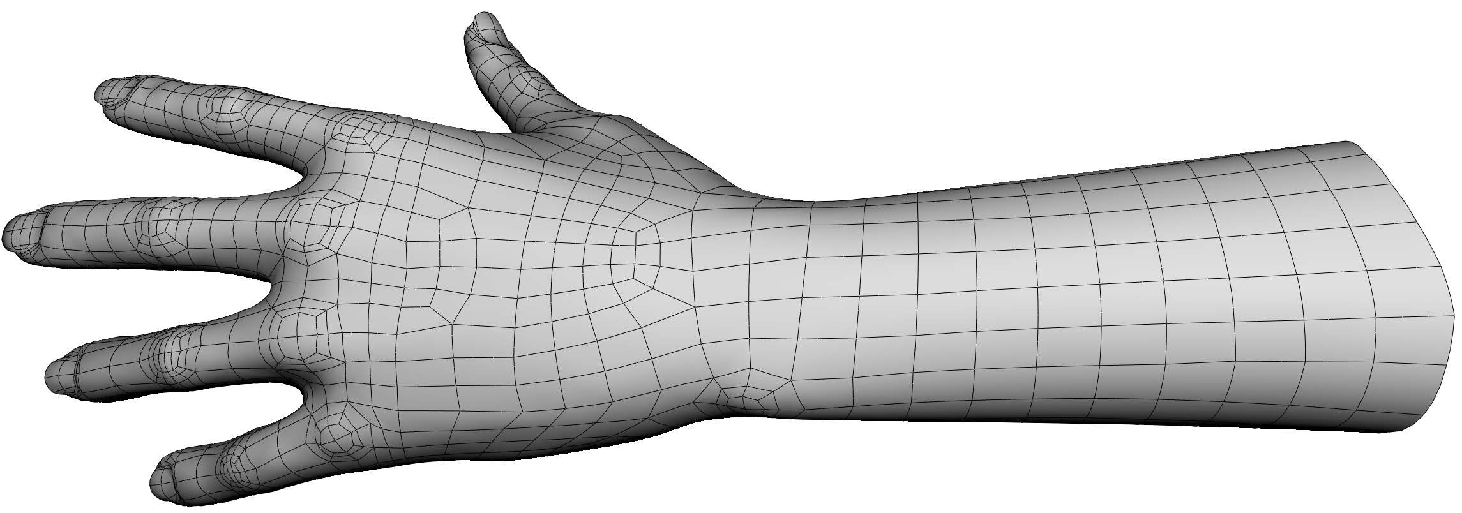
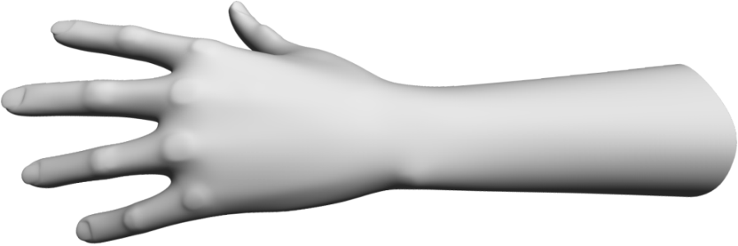
Catmull-Clark subdivision results

Slide 25
Artists’ feedback
Overall, very positive
Topology editing ➔ particularly appreciated
Spine sketching & autocompletion ➔ useful for initial exploration
Notes:
spine sketching & autocompletion were mainly used in the initial exploration, not used in the later stages
since they preferred the fine control offered by basic siketching toool

Slide 26
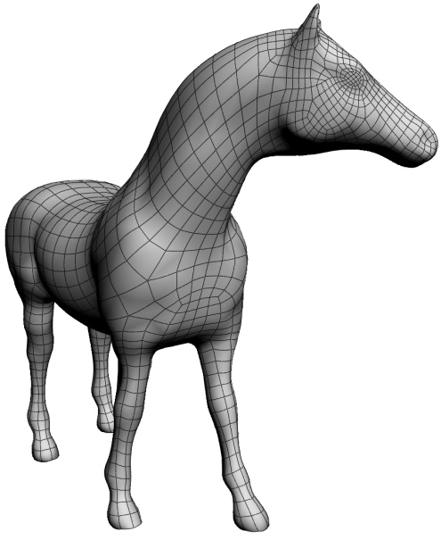
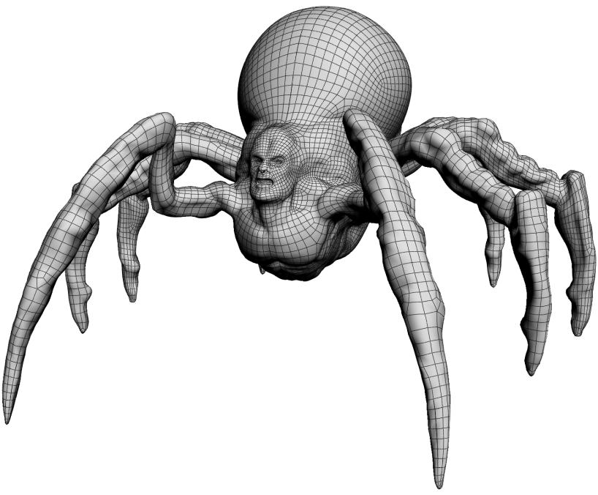
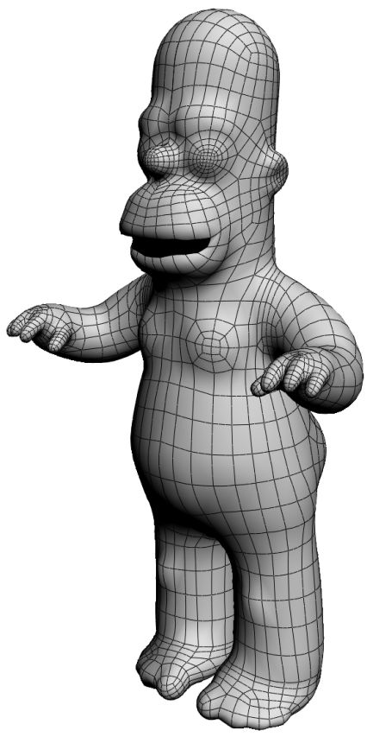
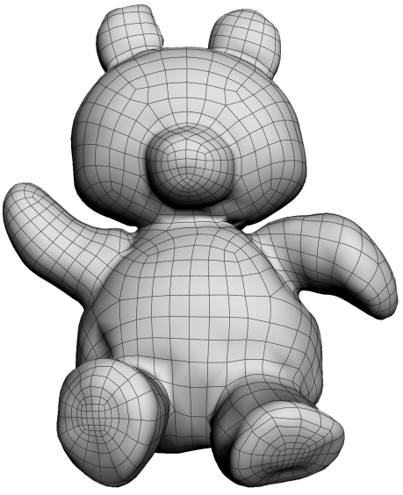
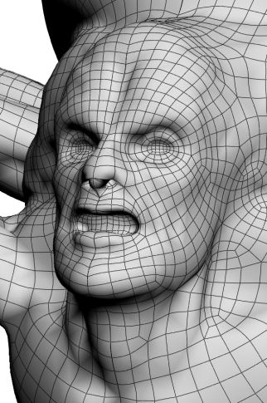
My results
50min
150min
40min
70min

Slide 27
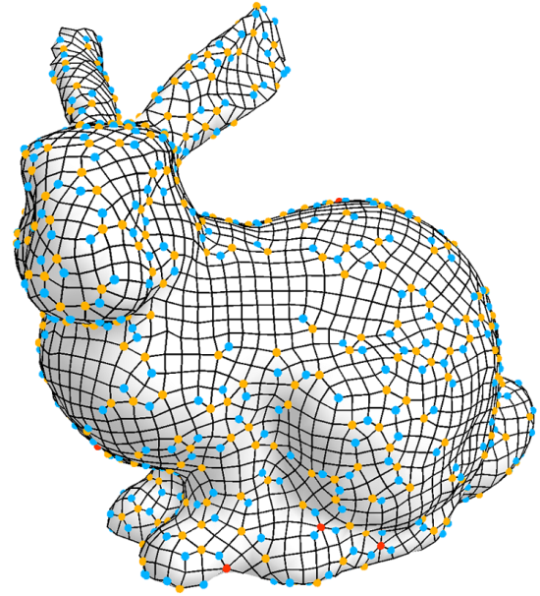
Editing existing quad meshes
[Peng11]
For globally structured quad mesh [Tarini11]
For unstructured quad mesh
➔ future work

Slide 28
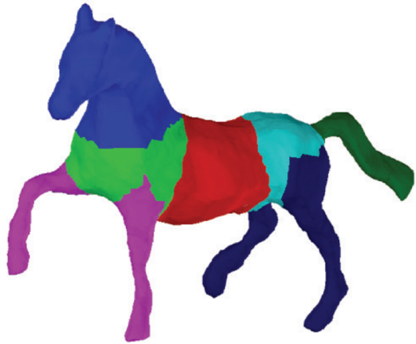
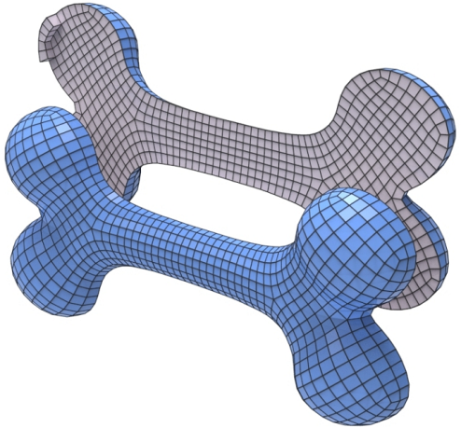
Limitations & future work
Combine with shape analysis
Support general N-sided patch
?
[Kalogerakis10]
Generalize to hex meshing
[Li12]

Slide 29
Acknowledgements
Maurizio Nitti (Disney)
Alessia Marra (Disney)
Jun Saito (Marza)
Supported by:
Japan Society for the Promotion of Science
ERC Starting Grant "iModel"
Swiss National Science Foundation
Adobe

Slide 30
Sketch-Based Generation and Editing of Quad Meshes
Kenshi Takayama
ETH Zurich
Daniele Panozzo
ETH Zurich
Alexander Sorkine-Hornung
Disney Research Zurich
Olga Sorkine-Hornung
ETH Zurich

Slide 31
“Spiral loop” problem

Slide 32
Comparison (by artist #1)
3D-Coat + Maya: 100min
Our tool: 45min
(2nd try)

